Slide 1
History of Historical Biogeography
By Nick Matzke

Slide 2
Some notes on my style
In addition to science, I was given a “liberal education”, i.e. lots of liberal arts. I can’t seem to shake it!
This means that I like to follow the influences between science and the broader society: history, philosophy, religion, culture, etc.
This can throw some science students, who might be more used to more “cut-and-dried,” “just the facts” presentations.
But: I think it is valuable to be exposed to these broader connections, just so you have some idea what people are doing over in the humanities departments, and why what they are doing might be useful (even to scientists!)

Slide 3
Some notes on my style
To help make these broader issues make sense, I sometimes:
Include quotes from key works, in the slides. Do not try to read these “live” during the presentation. They are there so you can go back and read them while reviewing the slides. (I have found this gets far more people to read a bit of the humanities material, than if I just mention it as supplemental reading that you have to dig up yourself.)
I sometimes do “animations”, where each slide adds an image or text. Yes, this makes there be more slides in the presentation, but it makes the presentation more portable to multiple formats than using Powerpoint’s animation functions.
I include lots of “background” / context / history. I think this is important as many current debates are actually just versions of ancient debates.

Slide 4
Statistical model choice in phylogenetic biogeography
Biogeography:
The geography of life

Slide 5
Statistical model choice in phylogenetic biogeography
Biogeography:
The geography of life

Slide 6
Statistical model choice in phylogenetic biogeography
Biogeography:
The geography of life
Ecological biogeography
Historical biogeography

Slide 7
Statistical model choice in phylogenetic biogeography
Biogeography:
The geography of life
Ecological biogeography
Historical biogeography
Focus: Environmental controls on distribution
Ecological interactions
Timescale: the Recent

Slide 8
Statistical model choice in phylogenetic biogeography
Biogeography:
The geography of life
Ecological biogeography
Historical biogeography
Focus: Environmental controls on distribution
Ecological interactions
Timescale: the Recent
Focus: Evolutionary history of distributions
Dispersal/vicariance events
Timescale: Millions of years

Slide 9
Statistical model choice in phylogenetic biogeography
Biogeography:
The geography of life
Ecological biogeography
Historical biogeography
Focus: Environmental controls on distribution
Ecological interactions
Timescale: the Recent
Focus: Evolutionary history of distributions
Dispersal/vicariance events
Timescale: Millions of years
2000s: PHYLOGENIES

Slide 10
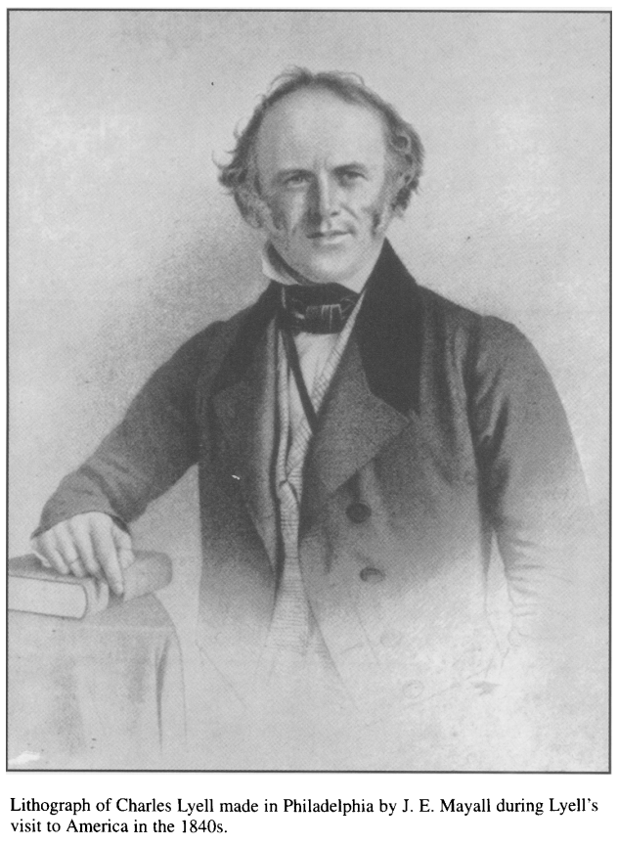
Statistical model choice in phylogenetic biogeography
Biogeography:
The geography of life
What is historical biogeography good for?
Charles Lyell: “The present is the key to the past.”
Flip it around: “The past is the key to the present.”

Slide 11
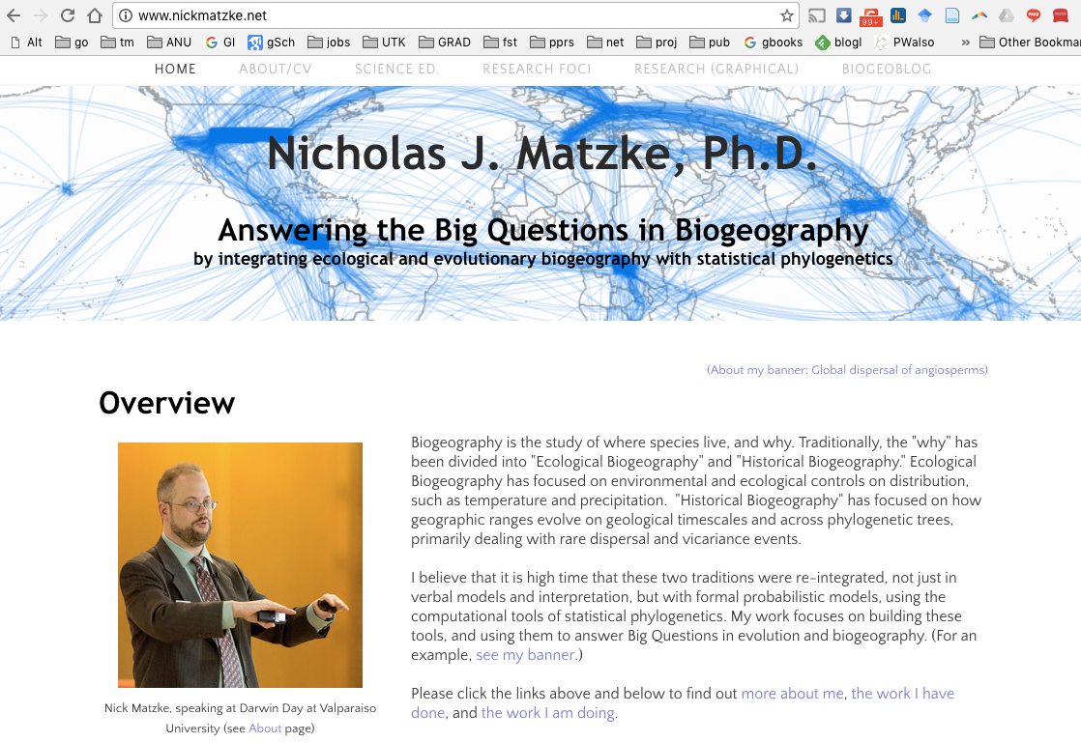
Please check out my website: http://www.nickmatzke.net

Slide 12
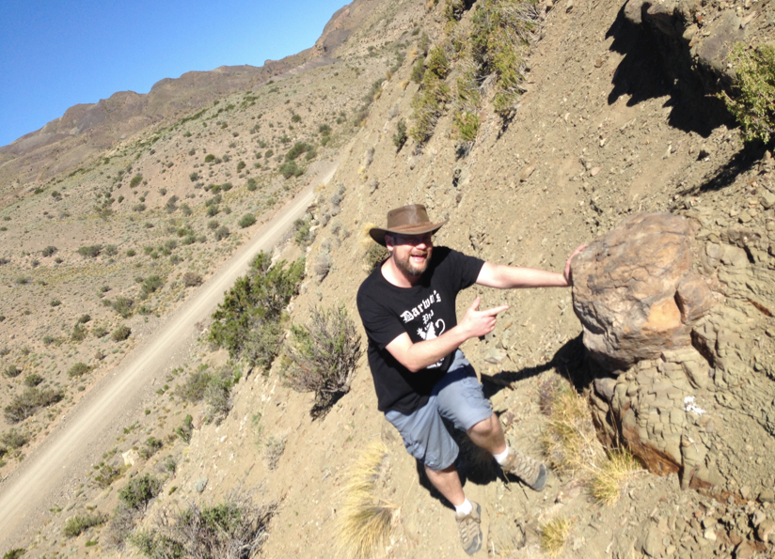
What are Big Questions in Biogeography?
1. Relative importance of dispersal versus vicariance
Nick at “Darwin’s Forest” (petrified Araucaria forest), 2017 Discovered by Darwin in Argentina, 1835

Slide 13
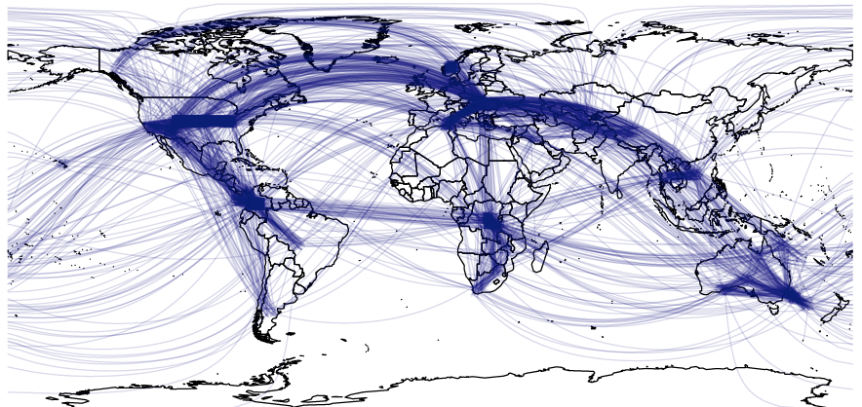
What are Big Questions in Biogeography?
1. Relative importance of dispersal versus vicariance
2. What is the distance-dispersal relationship over Deep Time?
Nick at “Darwin’s Forest” (petrified Araucaria forest), 2017 Discovered by Darwin in Argentina, 1835
BioGeoBEARS inference of dispersal events for 14,000 plant species

Slide 14
What are Big Questions in Biogeography?
1. Relative importance of dispersal versus vicariance
2. What is the distance-dispersal relationship over Deep Time?
Nick at “Darwin’s Forest” (petrified Araucaria forest), 2017 Discovered by Darwin in Argentina, 1835
3. Measuring importance of traits for dispersal
BioGeoBEARS inference of dispersal events for 14,000 plant species

Slide 15
What are Big Questions in Biogeography?
1. Relative importance of dispersal versus vicariance
2. What is the distance-dispersal relationship over Deep Time?
Nick at “Darwin’s Forest” (petrified Araucaria forest), 2017 Discovered by Darwin in Argentina, 1835
3. Measuring importance of traits for dispersal
Matzke: WITH MODEL-BASED INFERENCE!
BioGeoBEARS inference of dispersal events for 14,000 plant species

Slide 16
Major themes in (macro-scale) biogeography
Why do species live where they do?
- adapted vs. history
- dispersal vs. constraint/dispersal limitations
Pattern vs. process
- What (if anything) do patterns tell us about process?
- Equilibrium vs. non-equilibrium conditions
Distribution of diversity
- Why is there a latitudinal diversity gradient?
- speciation/extinction variation in time & space
What is the link between space and time?
- Can we learn about change in time from change in space?
Organisms as active (e.g. dispersalism) vs. passive (vicariance)

Slide 17
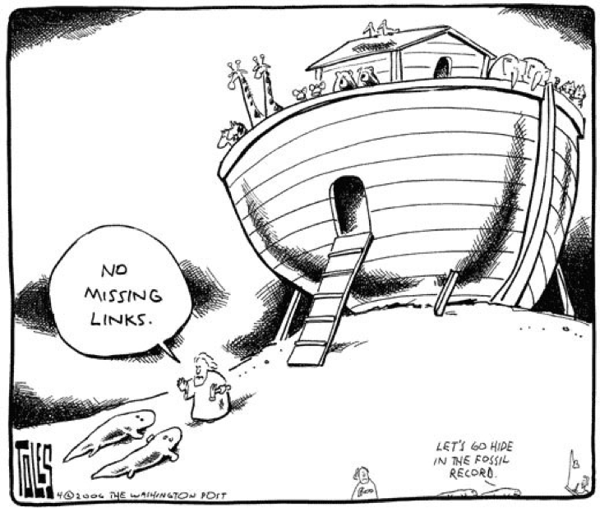
In the Beginning…

Slide 18
In the Beginning…

Slide 19
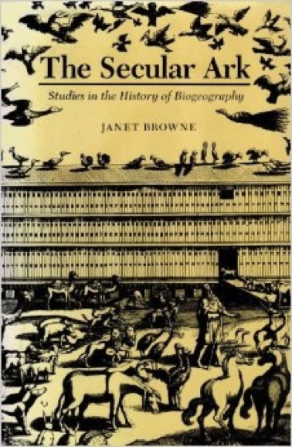
In the Beginning…
Janet Browne (1983).
The Secular Ark: Studies in the History of Biogeography Available free on JSTOR at:
http://dx.doi.org/10.2307/j.ctt1xp3sq3

Slide 20
In the Beginning…
It is pretty literally true to say that (Western, academic) speculation about historical biogeography (as with origins generally) began with the book of Genesis in the Bible
Of course, every culture has origins stories; whether stories like Noah’s Flood are even “western” can be debated, as they trace back to the middle east (similar, “homologous” stories are found in the Epic of Gilgamesh, from ancient Mesopotamia). Stories, especially significant ones, circulate across cultures, languages, etc.

Slide 21
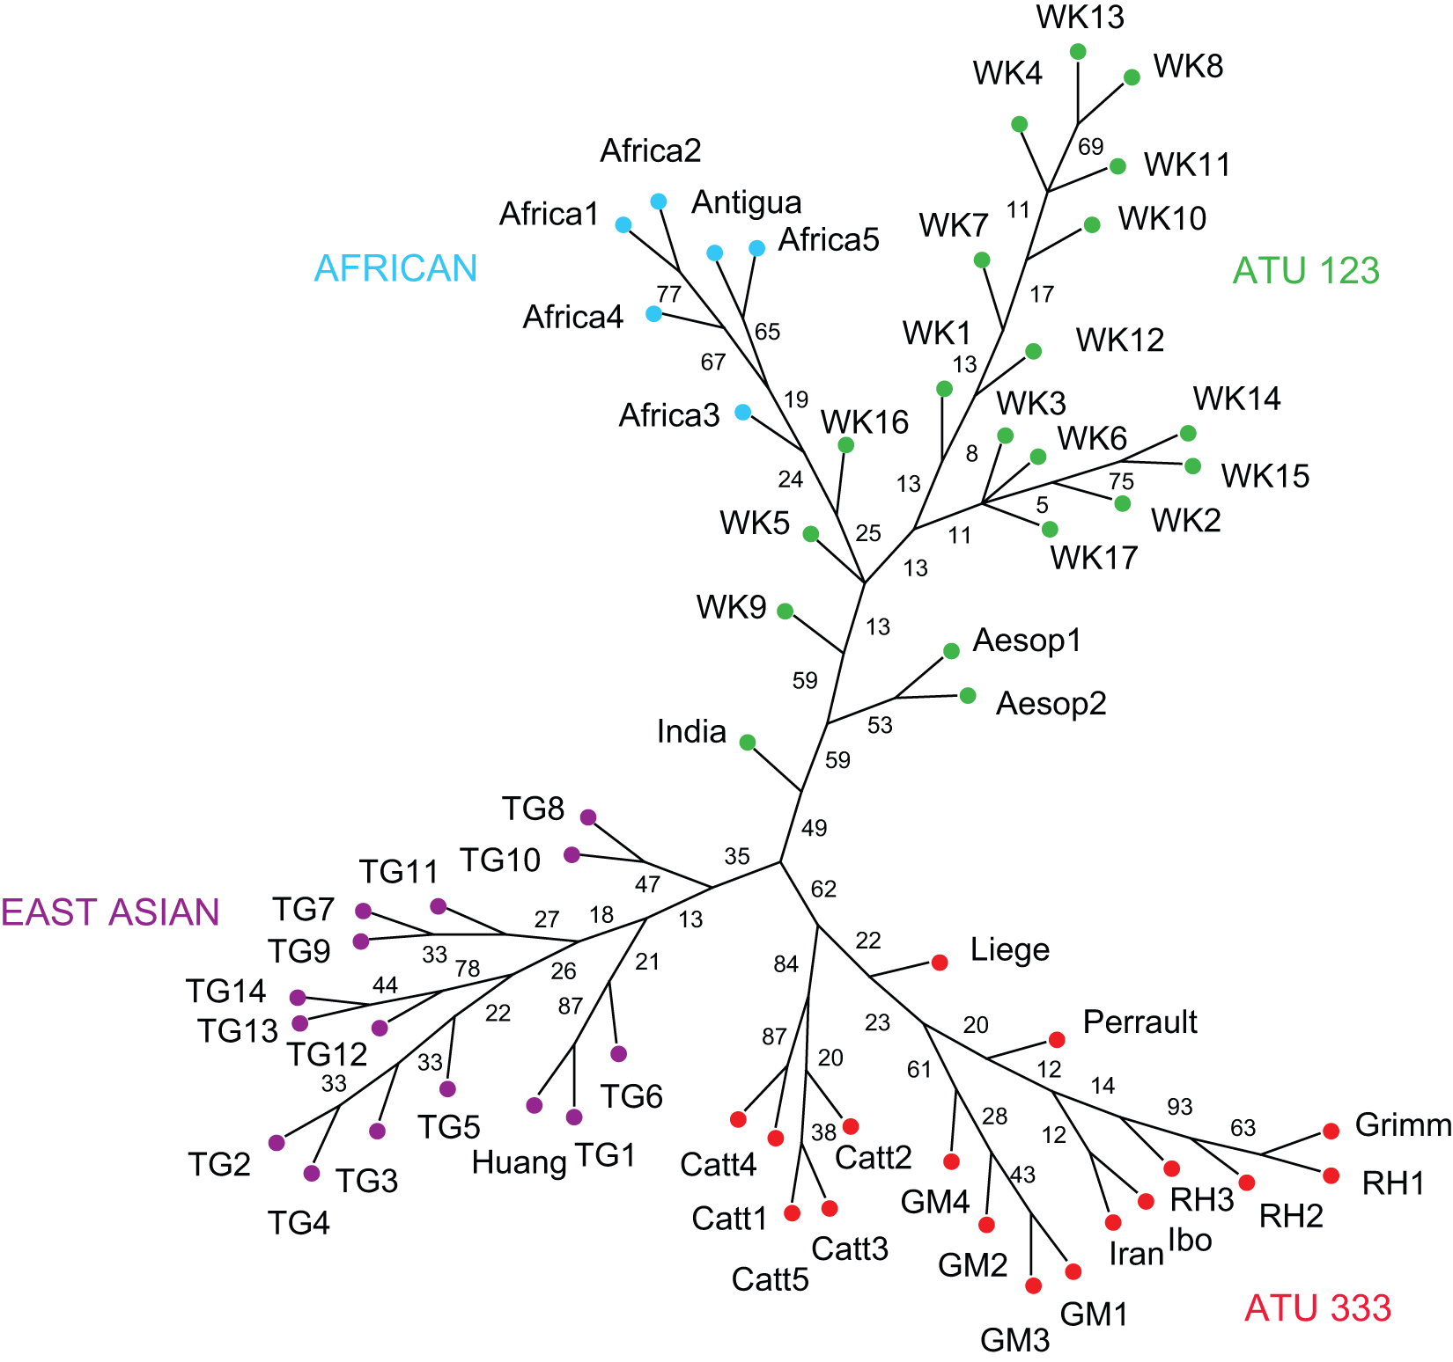
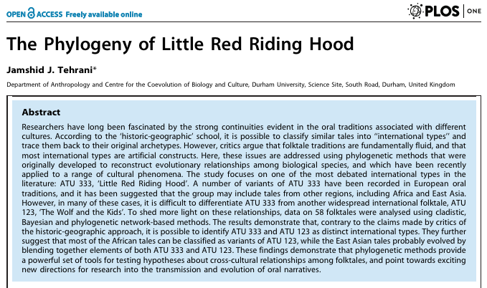
In the Beginning…
It is pretty literally true to say that (Western, academic) speculation about historical biogeography (as with origins generally) began with the book of Genesis in the Bible
Of course, every culture has origins stories; whether stories like Noah’s Flood are even “western” can be debated, as they trace back to the middle east (similar, “homologous” stories are found in the Epic of Gilgamesh, from ancient Mesopotamia). Stories, especially significant ones, circulate across cultures, languages, etc.
Some scientists even use phylogenetics to trace this cultural transmission!

Slide 22
In the Beginning…
Even in science, where we are devoted to developing well-tested, natural explanations of phenomena, it is worthwhile to delve deep into the historical origins of our fields, because
We can learn why certain major questions are framed the way they are
Terminology sometimes makes more sense when we understand its origins
Sometimes we discover that common assumptions in the field are unjustified / are disguising cultural/historical biases
Most important: “history is a different place…we don’t live there” – it is one way to see different ways of thinking, and of checking if our current scientific view is actually well-justified.

Slide 23
In the Beginning…
Even in science, where we are devoted to developing well-tested, natural explanations of phenomena, it is worthwhile to delve deep into the historical origins of our fields, because
We can learn why certain major questions are framed the way they are
Terminology sometimes makes more sense when we understand its origins
Sometimes we discover that common assumptions in the field are unjustified / are disguising cultural/historical biases
Most important: “history is a different place…we don’t live there” – it is one way to see different ways of thinking, and of checking if our current scientific view is actually well-justified.

Slide 24
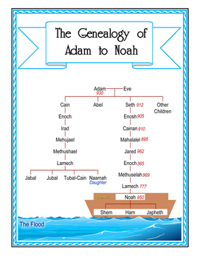
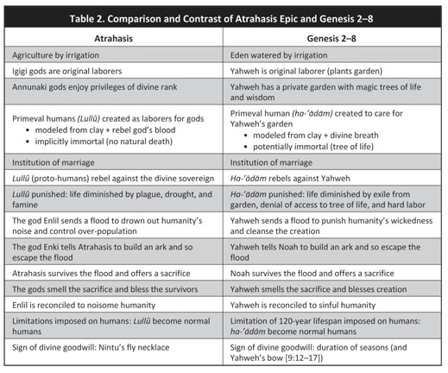
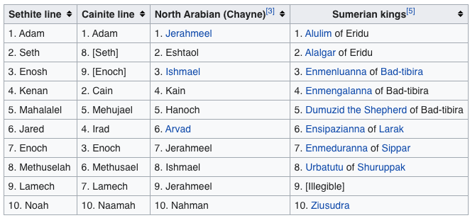
Noah’s Flood story…
Part of a longer set of accounts similar between the book of Genesis and other ancient middle-eastern stories:
https://www.teacherspayteachers.com/Product/Notebooking-Genesis-4-5-Genealogy-of-Adam-to-Noah-2636741
The “Generations of Adam” (from Adam to Noah)
https://en.wikipedia.org/wiki/Generations_of_Adam
Daniel C. Harlow (2010). After Adam: reading Genesis in an age of evolutionary science. Perspectives on Science and Christian Faith, 62(3). https://link.gale.com/apps/doc/A234714307/AONE?u=learn&sid=AONE&xid=ac0fc0fb

Slide 25
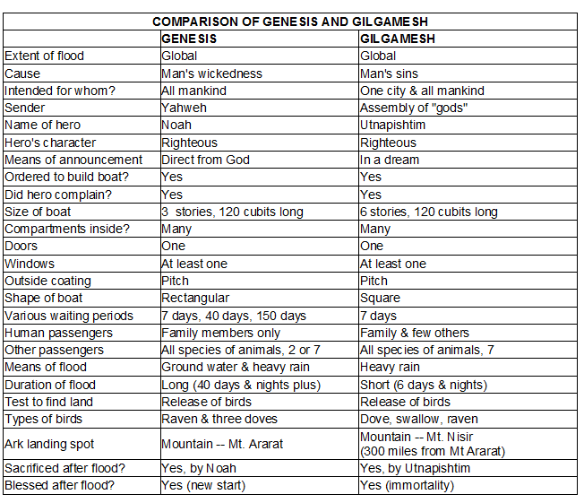
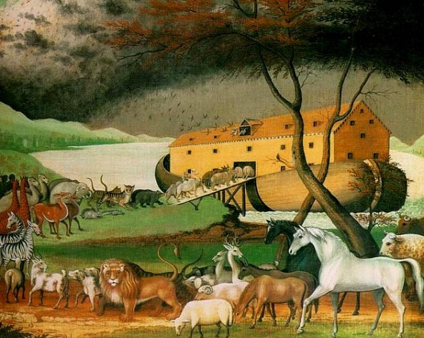
Noah’s Flood story…
One version of the story: God tells Noah to build the boat, as he is going to destroy the world because of man’s wickedness
‘Noah’s Ark’, Edward Hicks, 1846
https://www.quora.com/Is-Noahs-Ark-a-biblical-fairy-tale

Slide 26
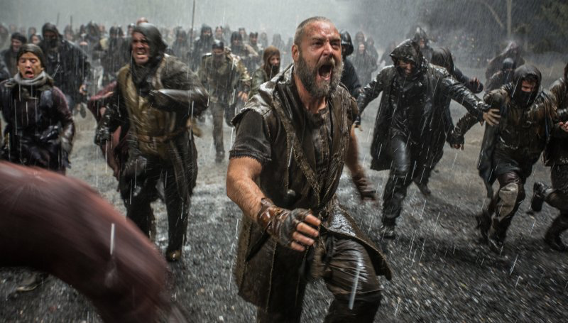
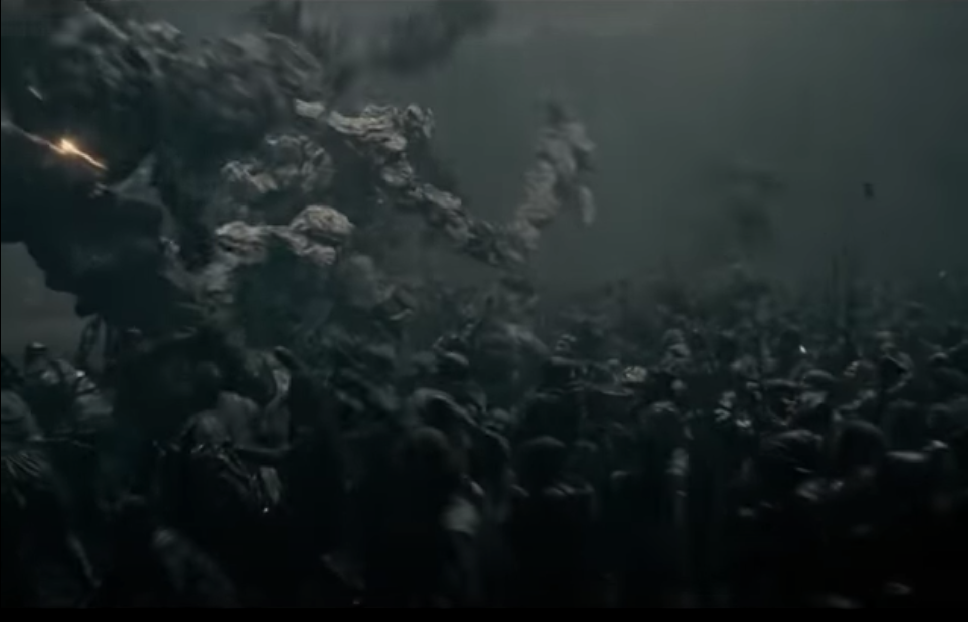
Noah’s Flood story…
Then Russell Crowe-Noah and his rock-monster friends fight all the bad guys to keep them off the Ark
Noah (2014), starring Russell Crowe
https://time.com/42274/ken-ham-the-unbiblical-noah-is-a-fable-of-a-film/
Noah (2014) fight scence: https://www.youtube.com/watch?v=3IMBJyztU2Q

Slide 27
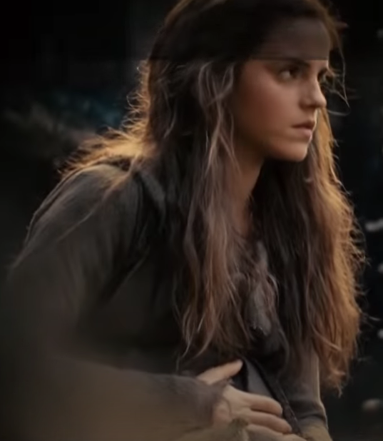
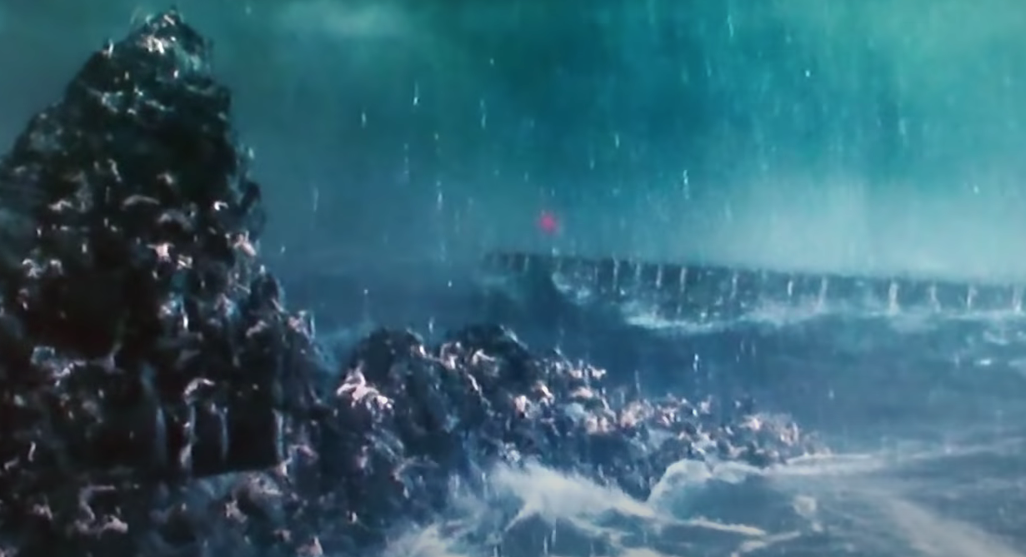
Noah’s Flood story…
Then everyone else drowned, and Emma Watson got pregnant on the Ark…
Noah (2014) drowning: https://www.youtube.com/watch?v=H2aEUPnytD8
Noah (2014), starring Russell Crowe

Slide 28
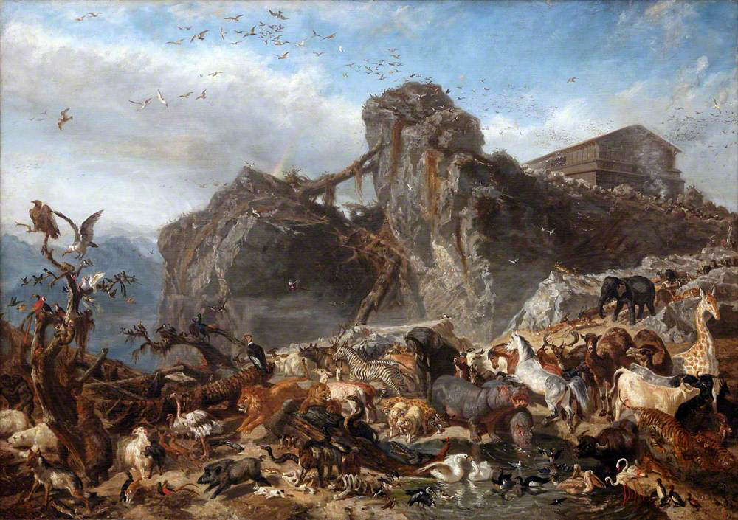
Noah’s Flood story…
After 40 days and 40 nights, the Ark came to rest on Mt. Ararat
The Animals Leaving the Ark, Mount Ararat, by Filippo Palizzi (1818–1899) https://artuk.org/discover/artworks/the-animals-leaving-the-ark-mount-ararat-14683

Slide 29
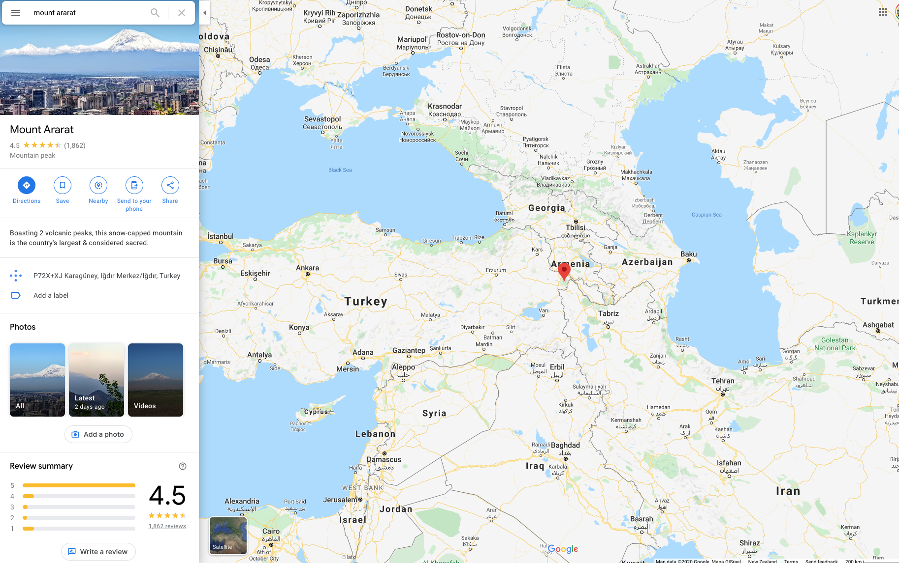
Noah’s Flood story…
After 40 days and 40 nights, the Ark came to rest on Mt. Ararat

Slide 30
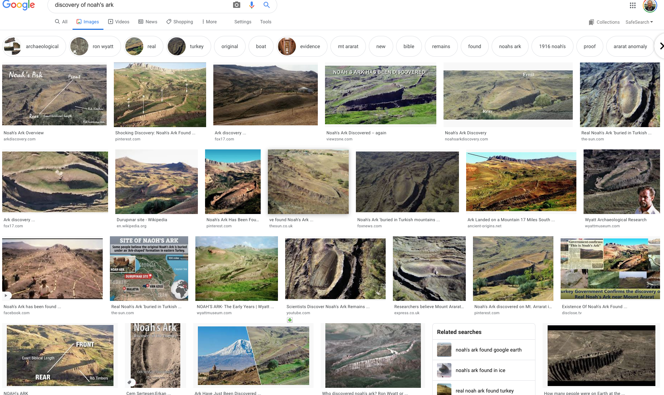
Noah’s Flood story…
Leading to hundreds of attempts by modern fundamentalists to imagine they’ve rediscovered the Ark in Eastern Turkey:

Slide 31
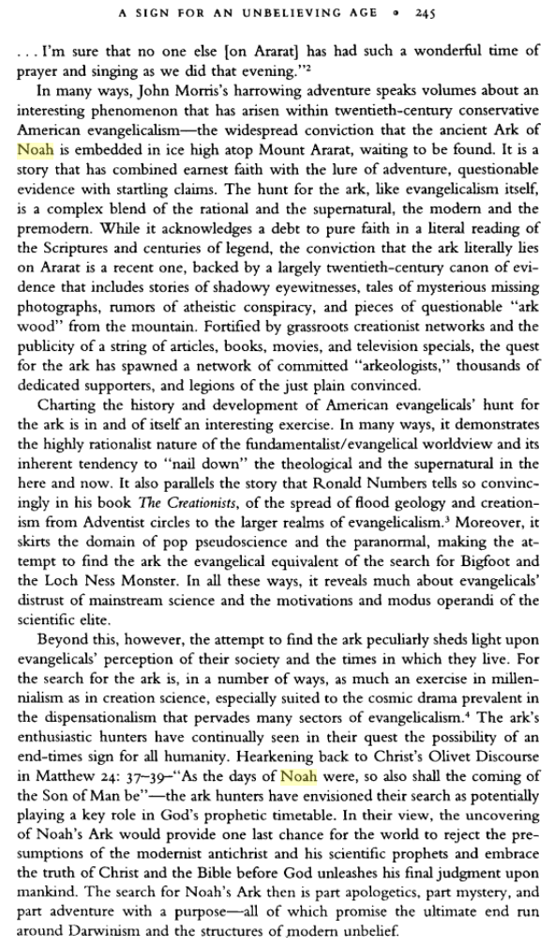
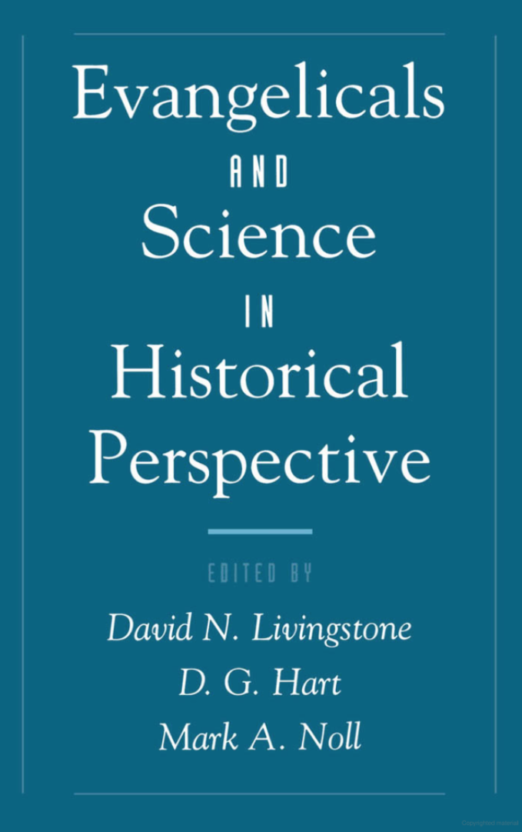
(More on what motivates the modern fundamentalists’ search for Noah’s Ark)
Eskridge, Larry (1999). "A Sign for an Unbelieving Age: Evangelicals and the Search for Noah's Ark". In David N. Livingstone (ed.). Evangelicals and Science in Historical Perspective. D. G. Hart, Mark A. Noll. Oxford UP. https://www.google.co.nz/books/edition/Evangelicals_and_Science_in_Historical_P/_4K720YRj88C?hl=en&gbpv=0

Slide 32
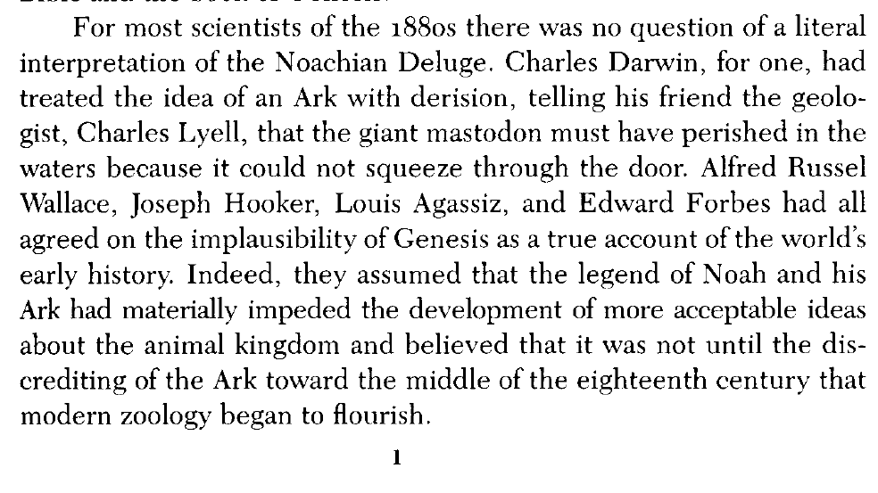
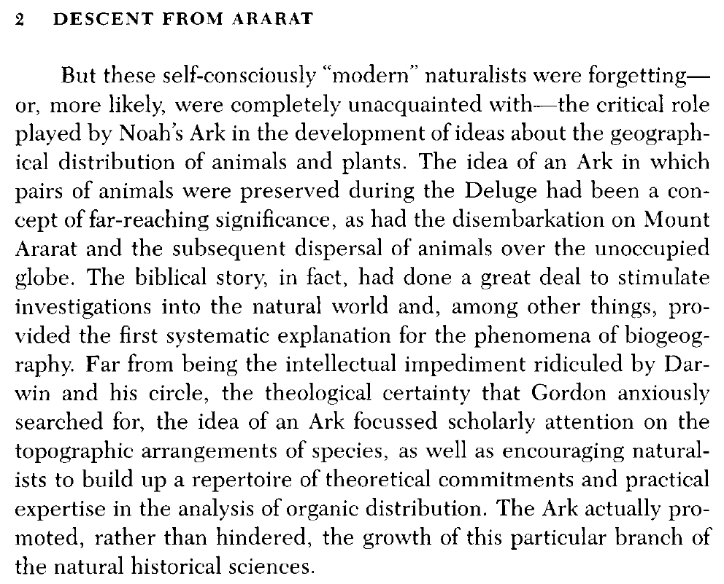
Back to biogeography
Janet Browne (1983).
The Secular Ark: Studies in the History of Biogeography

Slide 33
Back to biogeography
Janet Browne (1983).
The Secular Ark: Studies in the History of Biogeography

Slide 34
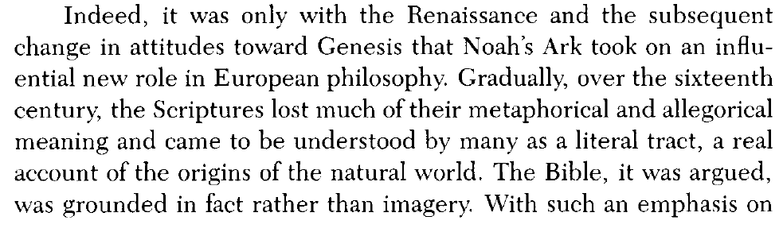
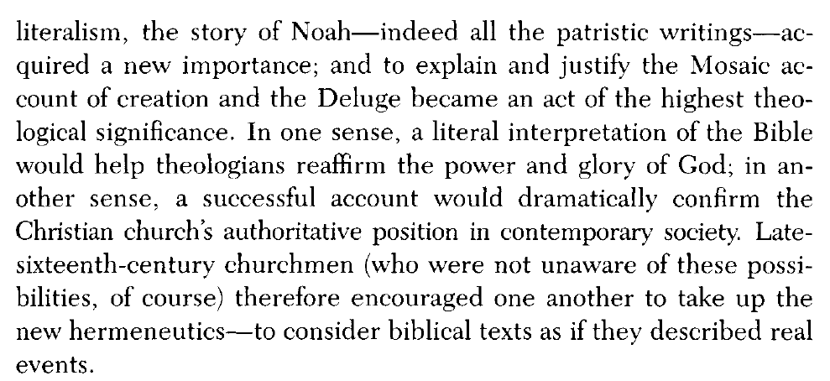
Early modern science + Bible = literalism
Janet Browne (1983).
The Secular Ark: Studies in the History of Biogeography

Slide 35
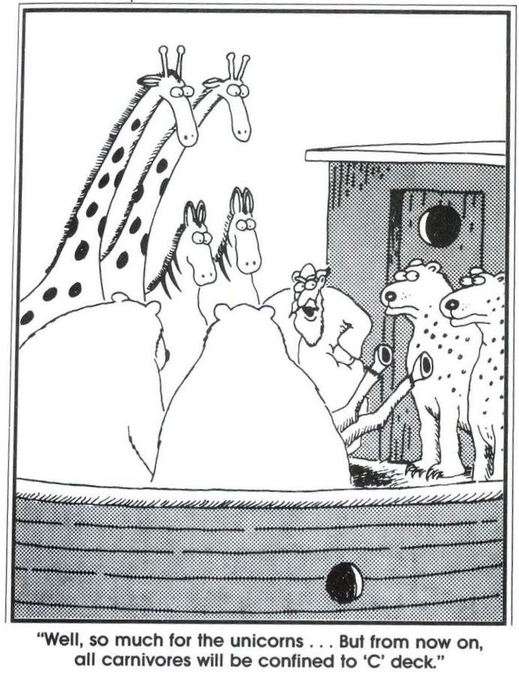
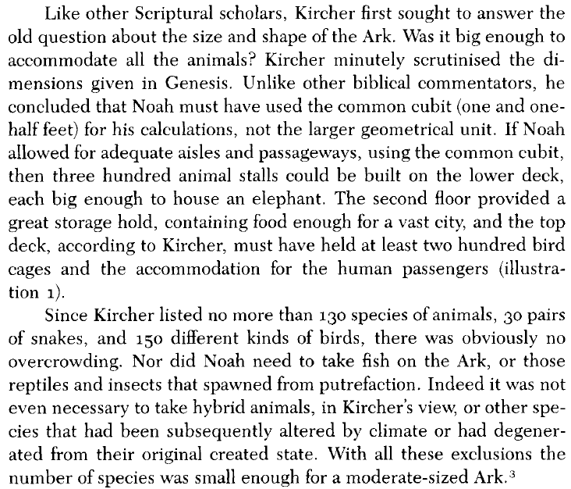
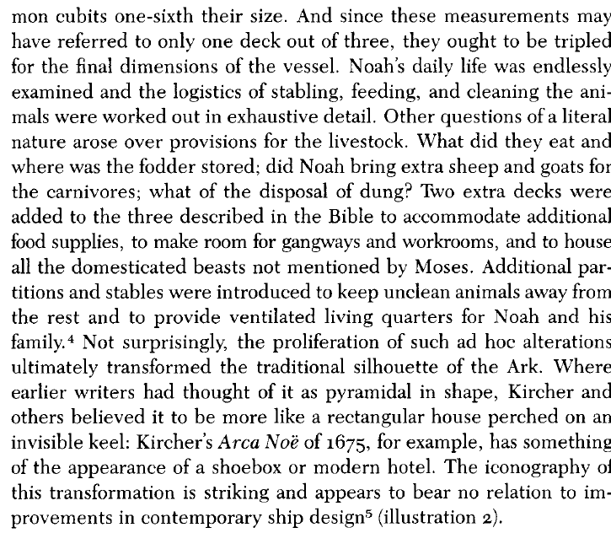
But once you start to take things literally, questions arise…
How to fit everything on the ark?
Janet Browne (1983).
The Secular Ark: Studies in the History of Biogeography

Slide 36
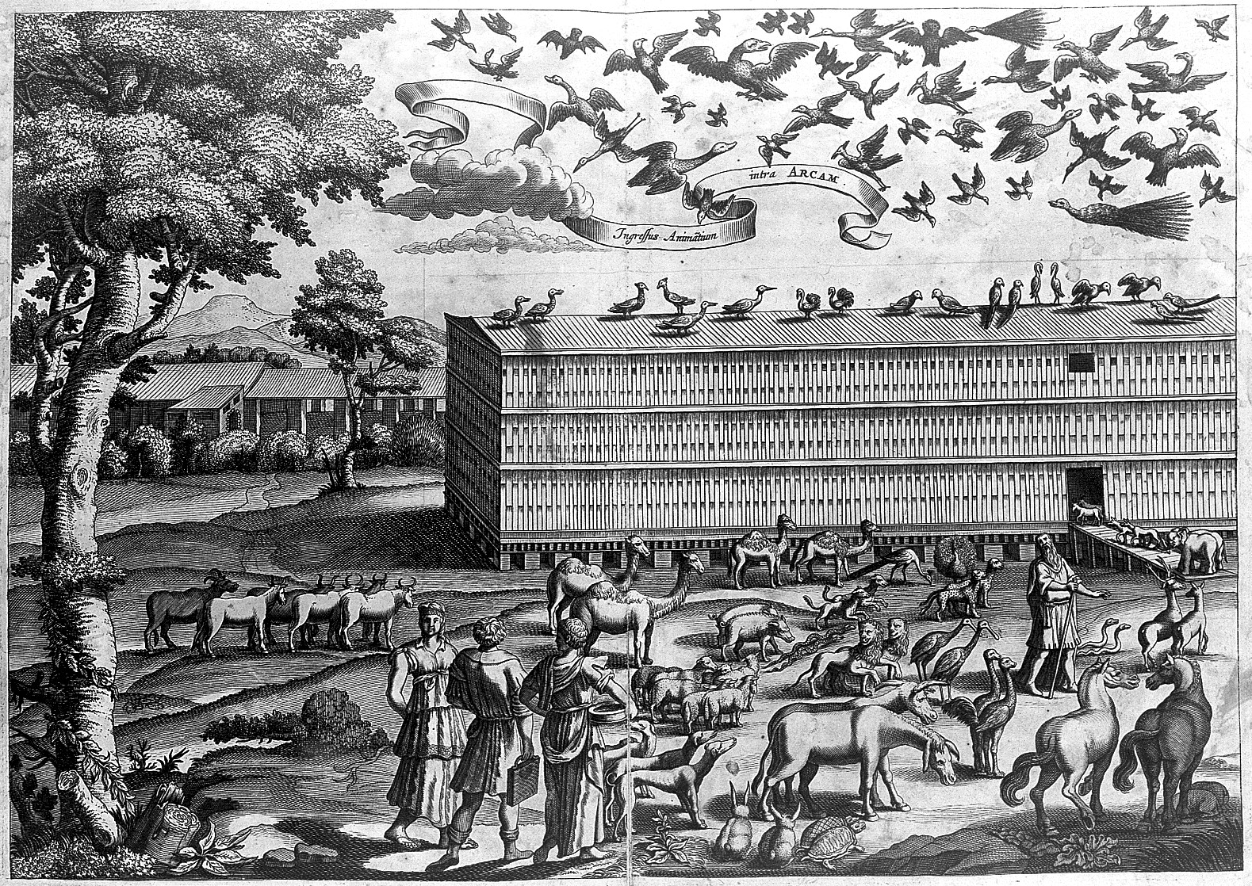
Packing the animals on the ark:
Arca Noe, entry of animals, by A. Kircher (1675). http://catalogue.wellcomelibrary.org/record=b1310145

Slide 37
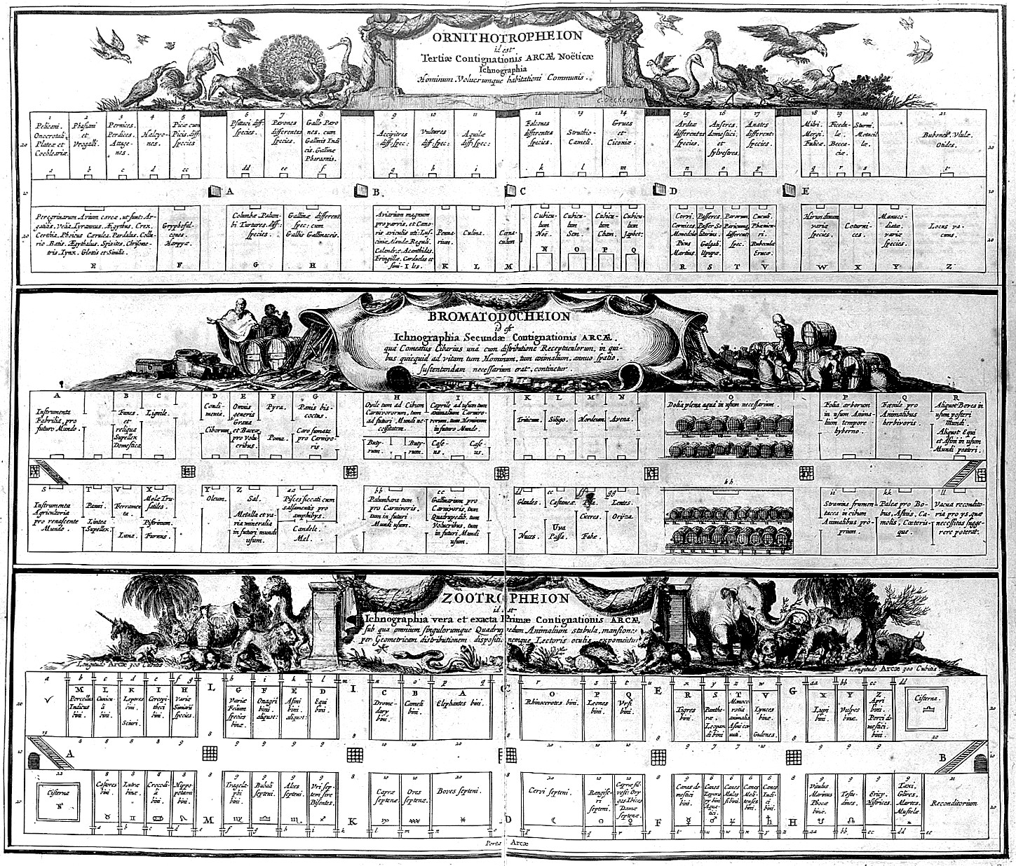
Packing the animals on the ark:
Arca Noe, arrangement inside ark, by A. Kircher (1675). http://catalogue.wellcomelibrary.org/record=b1310145

Slide 38
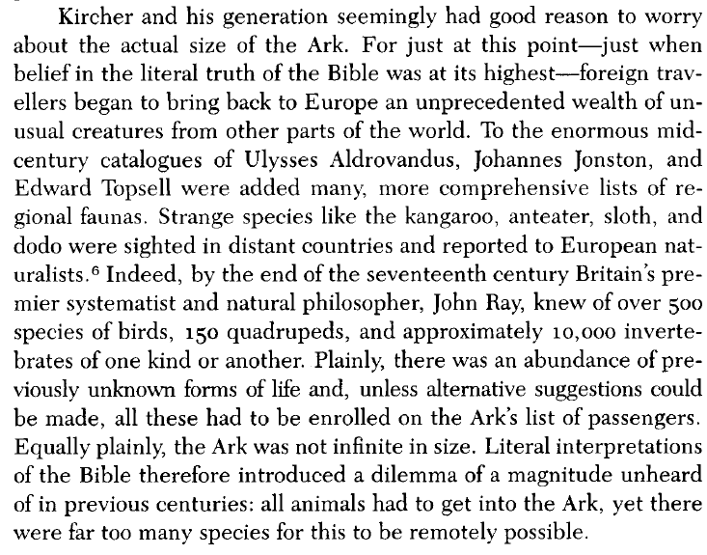
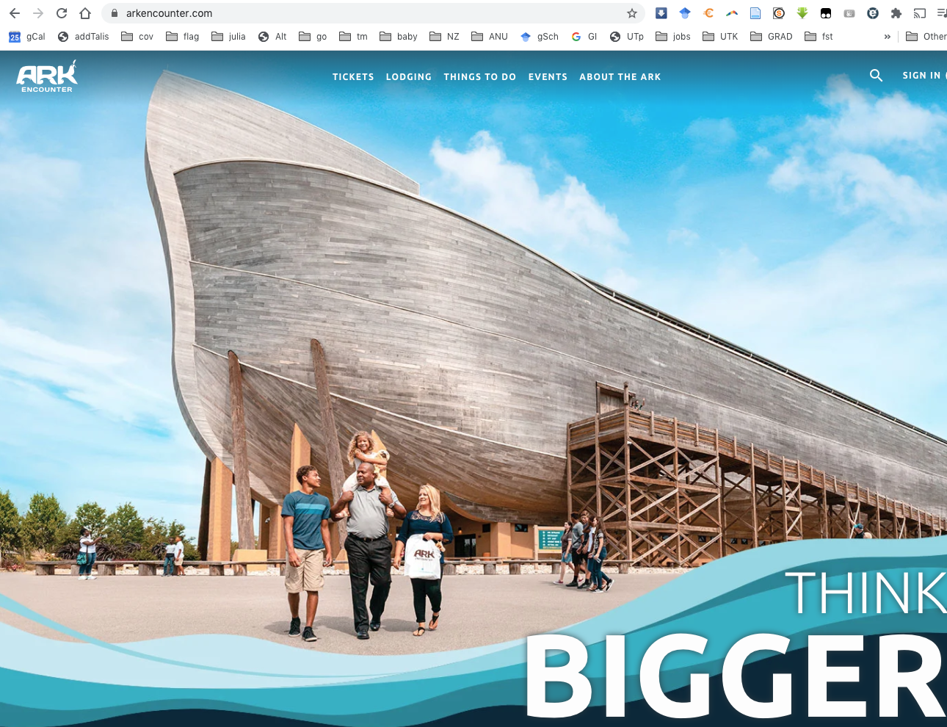
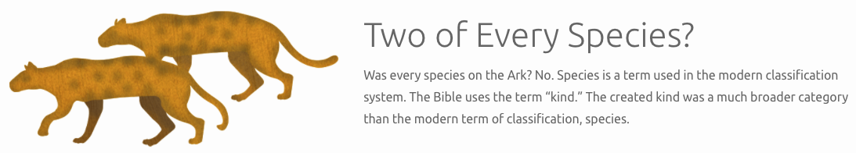
OK fine. But what if you discover more animals?
Browne 1983:
Let’s look at a 2020 estimate from Answers in Genesis:
https://arkencounter.com/

Slide 39
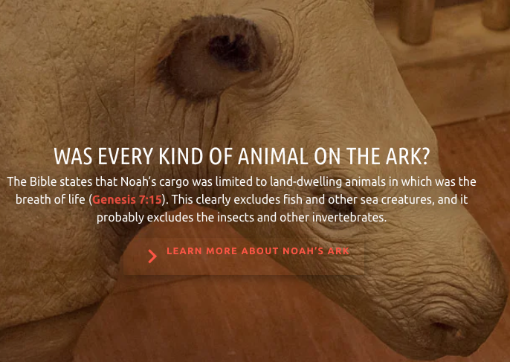
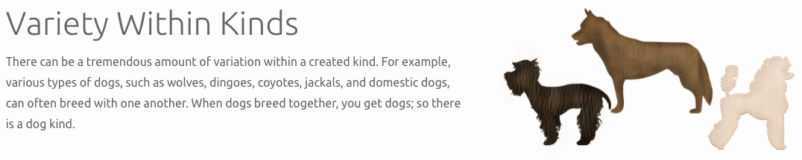
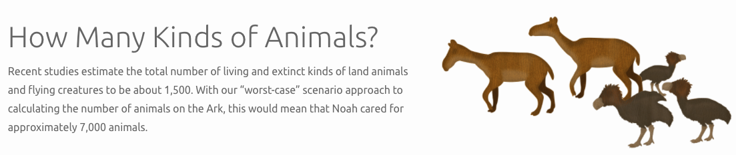
Modern creationists: “kinds” instead of species
https://arkencounter.com/animals/how-many/

Slide 40
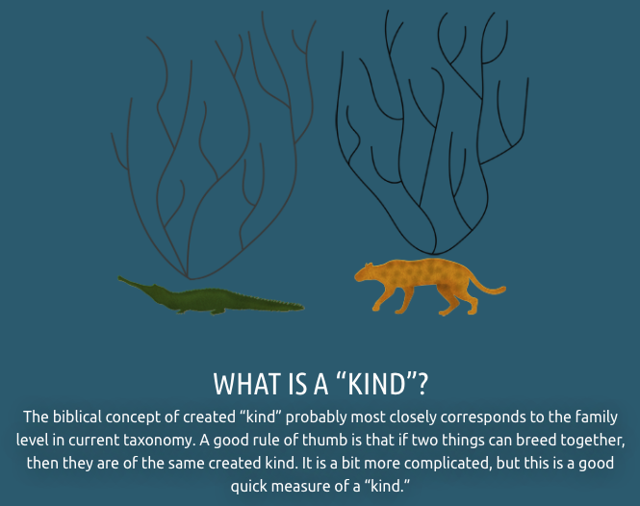
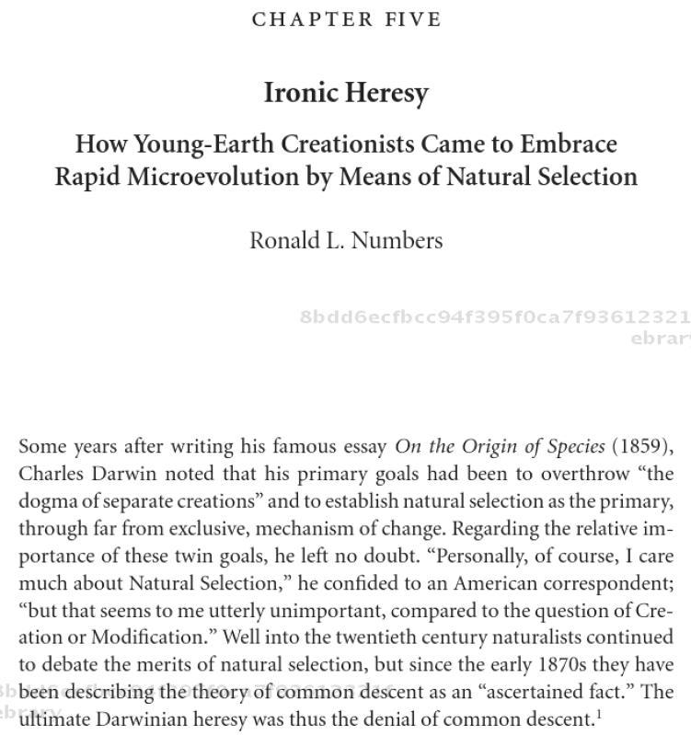
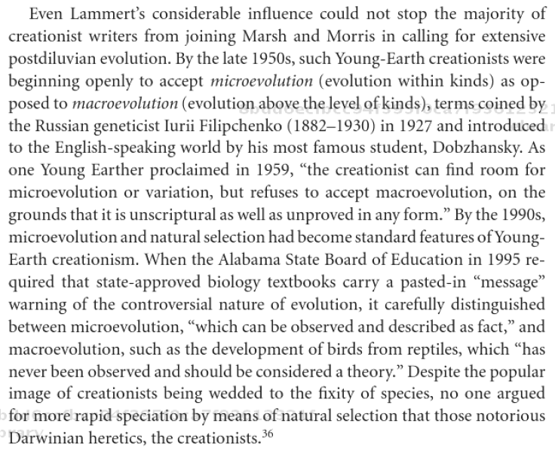
Modern creationists: “kinds” instead of species
https://arkencounter.com/animals/how-many/
Numbers, Ronald L. (2004). How Young-Earth Creationists Came to Embrace Rapid Microevolution by Means of Natural Selection. Darwinian Heresies. Cambridge University Press, 84-100. http://site.ebrary.com/id/10131737?ppg=94

Slide 41
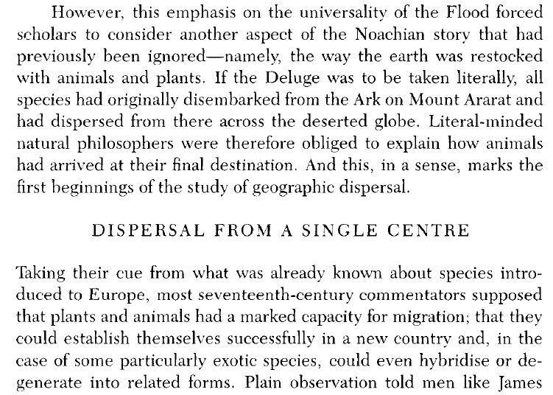
OK, even if you can fit everything on the Ark… how did they get from Ararat to around the world?
Janet Browne (1983).
The Secular Ark: Studies in the History of Biogeography

Slide 42
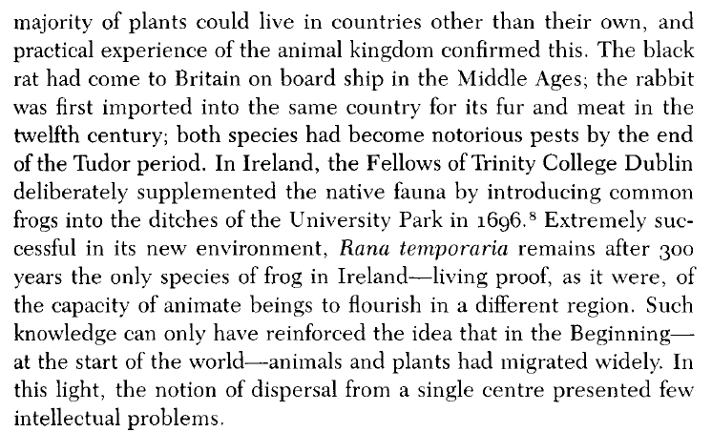
The first dispersalists!
Janet Browne (1983).
The Secular Ark: Studies in the History of Biogeography

Slide 43
The first dispersalists!
Janet Browne (1983).
The Secular Ark: Studies in the History of Biogeography

Slide 44
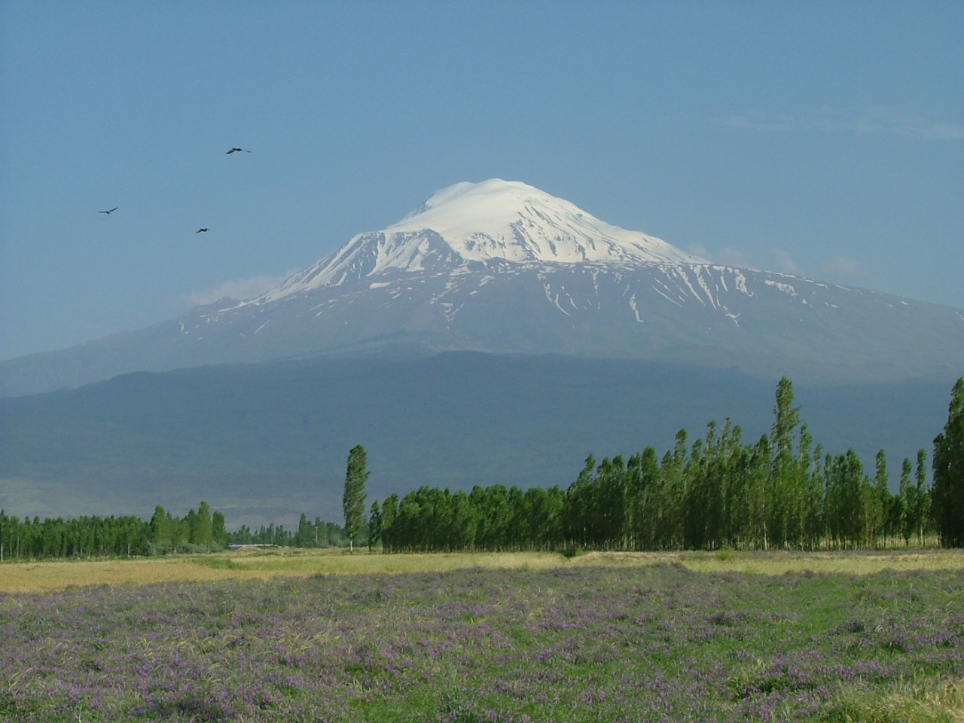
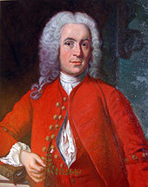
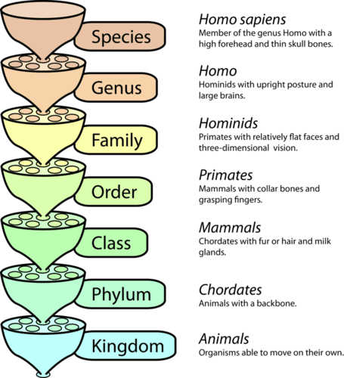
Linnaeus' Paradisical Mountain Hypothesis
Mid-1700s:
Linnaeus dispensed with the Ark (too many species!), but substituted a tropical island, that became a mountain as the waters receded (e.g. Ararat) with all the species from tropical lowlands to alpine
Mount Ararat, Turkey

Slide 45
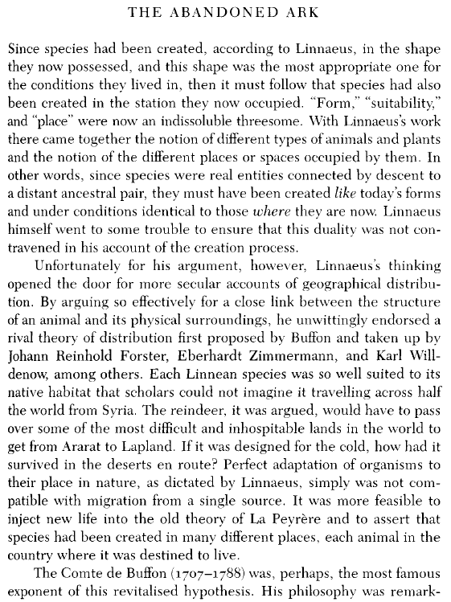
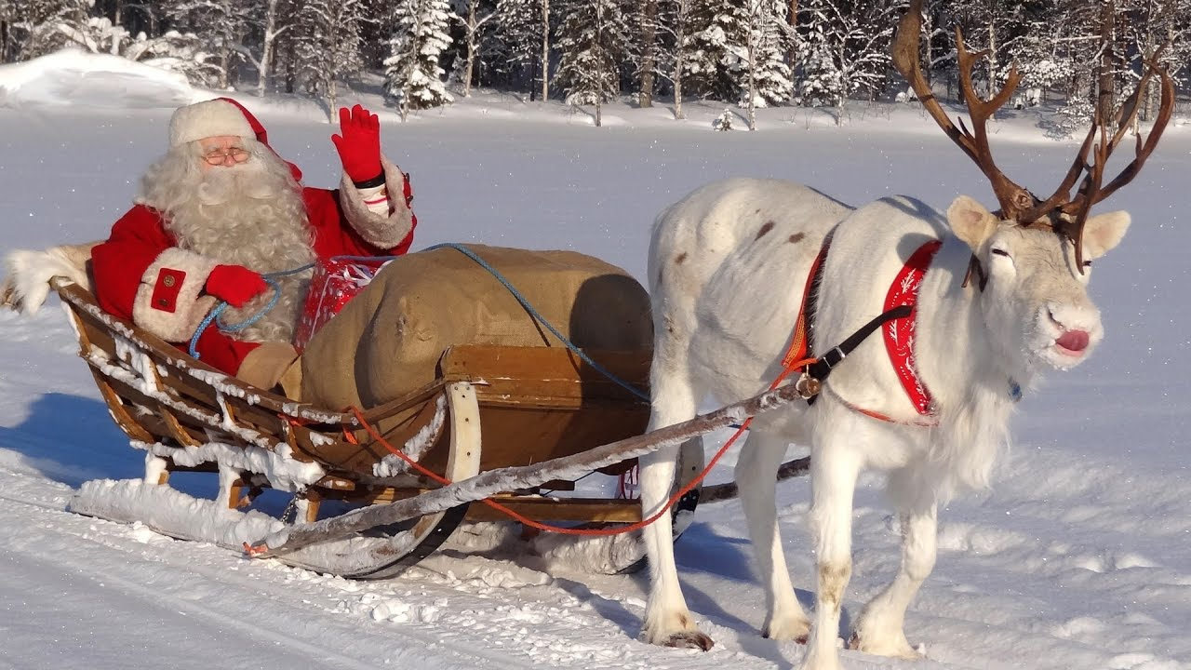
If organisms are designed for their environments, how could they disperse??
E.g. how do you get reindeer from the mountaintop to the Arctic?
https://www.youtube.com/watch?v=ZM7zi4jQgAU

Slide 46
If organisms are designed for their environments, how could they disperse??
E.g. how do you get reindeer from the mountaintop to the Arctic?
https://www.youtube.com/watch?v=ZM7zi4jQgAU

Slide 47
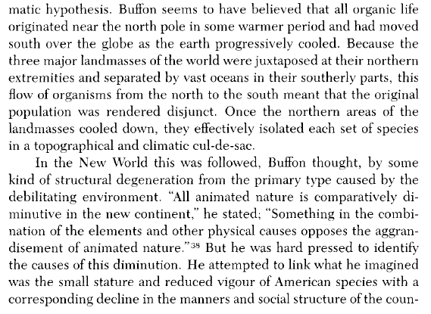
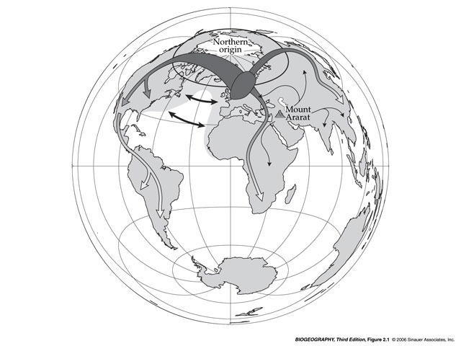
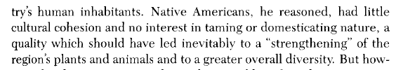
Buffon: Northern centre of origin, followed by degeneration
Views from:
Georges-Louis Leclerc, Comte de Buffon (and colleagues)
Histoire naturelle, générale et particulière, written in 44 quarto volumes between 1749 and 1809
Buffon’s Law: environmentally similar regions that are geographically isolated have distinct assemblages of mammals and birds
Northern origins:
(Hello, colonialist attitudes!)

Slide 48


(An aside: Thomas Jefferson rebuttal: hey Buffon, look at this moose!)
A moose. Which is big.
https://www.americanscientist.org/article/jefferson-buffon-and-the-moose

Slide 49




Banks and Foster (on Cook’s voyages)
Johann Reinhold Forster (1729-1798)
Sir Joseph Banks (1743-1820)
They extend Buffon’s Law to plants: different regions have different plants, even if they are environmentally similar
Forster
Also: the tropical diversity gradient
Fig. 4, p. C-3 of: M.R. Willig, D.M. Kaufman, and R.D. Steven (2003). “Latitudinal Gradients of Biodiversity: Pattern, Process, Scale, and Synthesis.” Annual Reviews of Ecology, Evolution, and Systematics. 34(1), 273-309.
doi: 10.1146/annurev.ecolsys.34.012103.144032
Banks

Slide 50

Banks and Foster (on Cook’s voyages)
Forster: kind of the opposite of Buffon:
Forster
Tropical diversity gradient
(early version of the temperature hypothesis)
Fig. 4, p. C-3 of: M.R. Willig, D.M. Kaufman, and R.D. Steven (2003). “Latitudinal Gradients of Biodiversity: Pattern, Process, Scale, and Synthesis.” Annual Reviews of Ecology, Evolution, and Systematics. 34(1), 273-309.
doi: 10.1146/annurev.ecolsys.34.012103.144032

Slide 51


Multiple mountains, one for each botanical province
Karl Willdenow (1765-1812)

Slide 52


Multiple mountains, one for each botanical province
Willdenow (1805)
A modern classification (https://www.britannica.com/place/Europe/Plant-life )

Slide 53



Alexander von Humboldt: Geographical and Latitudinal Zones
We might call this kind of biogeography “environmentalist”, or “ecological”.
Little concern about origins.
(It’s still the kind of biogeography you can find in Geography Departments!)
https://www.britannica.com/science/biome
Browne, Janet (1983). The Secular Ark. Pp. 55-56.

Slide 54


Alexander von Humboldt: Botanical arithmetic
Although origins questions were left aside temporarily, methods and “science of pattern” were developed.
E.g. counting genera, families, ratios:
(presaging phylodiversity studies!)
Browne, Janet (1983). The Secular Ark. p. 61.

Slide 55


Robert Brown (1773-1858)
Botanist, taxonomist, microscopist
Naturalist for Flinders in Australia
Collected 3000+ plants
Discovered “Brownian motion” (which later led to Einstein’s (1905) proof of the existence of atoms)
Botanical arithmetic applied to origins: - Early example of diversity = centre of origin hypothesis:
(Still a common assumption today – although not without its problems!)
Browne, Janet (1983). The Secular Ark. p. 62.

Slide 56

Return to origins
Louis Agassiz (1850). "Geographical Distribution of Animals." Christian Examiner and Religious Miscellany, 48: 181-204.
“There is a prevailing opinion, which ascribes to all living beings upon earth one common centre of origin”
“There is another view, to which, more recently, naturalists have seemed to incline; namely, the assuming several centres of origin, from which organized beings were afterwards diffused over wider areas, in the same manner as according to the first theory, the difference being only in the assumption of several centres of dispersion instead of a single one.”
“[W]e have been gradually led to the conclusion, that most animals and plants must have originated primitively over the whole extent of their natural distribution”
Agassiz (1807-1873); Swiss; founded Museum of Comparative Zoology at Harvard, founder of American zoology; invented “Ice Age”(s); polygenist (ie separate creation of animals/plants and human populations! Not surprisingly, he was pretty racist, although not pro-slavery). https://commons.wikimedia.org/wiki/File:Louis_Agassiz_H6.jpg

Slide 57

Return to origins
Alfred Russel Wallace (1855). “On the law which has regulated the introduction of new species.” Annals and Magazine of Natural History 16 (2nd ser.): 184-196.
“Why are the genera of Palms and of Orchids in almost every case confined to one hemisphere? Why are the closely allied species of brown-backed Trogons all found in the East, and the green-backed in the West? Why are the Macaws and the Cockatoos similarly restricted? Insects furnish a countless number of analogous examples;--the Goliathi of Africa, the Ornithopteræ of the Indian islands, the Heliconidæ of South America, the Danaidæ of the East, and in all, the most closely allied species found in geographical proximity. The question forces itself upon every thinking mind,--why are these things so? They could not be as they are, had no law regulated their creation and dispersion.”

Slide 58


Darwin in 1835 (returning home)
December 30th, 1835: Darwin leaves Bay of Islands, New Zealand
January 18th, 1836, Journal of Researches (“Voyage of the Beagle”), in Australia:
I had been [. . .] reflecting on the strange character of the animals of this country as compared with the rest of the world. An unbeliever in every thing beyond his own reason might exclaim, 'Two distinct Creators must have been at work; their object, however, has been the same, and certainly the end in each case is complete.' While thus thinking, I observed the hollow conical pitfall of the lion-ant: first a fly fell down the treacherous slope and immediately disappeared; then came a large but unwary ant; it struggles to escape being very violent, those curious little jets of sand [. . .] were promptly directed against the expected victim. But the ant enjoyed a better fate than the fly, and escaped the fatal jaws which lay concealed at the base of the conical hollow. There can be no doubt but that this predacious larva belongs to the same genus with the European kind, though to a different species. Now what would the sceptic say to this? Would any two workmen ever have hit upon so beautiful, so simple, and yet so artificial a contrivance? It cannot be thought so: one Hand has surely worked throughout the universe (Darwin 1989 [1839], 325).
“Two distinct Creators must have been at work…”
Special creation eventually leads to the idea that you have different creators in different regions…heresy!
http://www.antlionpit.com/darwin.html

Slide 59
1859: Darwin
“When on board H.M.S. Beagle as naturalist, I was much struck with certain facts in the distribution of the organic beings inhabiting South America…” (Introduction to On the Origin of Species).
E.g.:
ant lions in Australia vs. Eurasia
fossil & living armadillos
rheas in South America
similarity of Galapagos flora & fauna to South America (but with differentiation
(years later) Galapagos finches

Slide 60


Common ancestry solved problems
Wallace (1855): “Every species has come into existence coincident both in space and time with a pre-existing closely allied species.”
Darwin (1859): “the more nearly any two forms are related in blood, the nearer they will generally stand to each other in time and space”.

Slide 61
Common ancestry solved problems
Darwin (1859): “the more nearly any two forms are related in blood, the nearer they will generally stand to each other in time and space”.
A statement of pattern. In modern (statistical!) terms:
Spatial autocorrelation (similarity increases over shorter distances)
Cross-correlation: physical similarity correlates with geographic similarity
within species
across similar species
across floras/faunas
A statement of process: these patterns are explained by common ancestry
I.e., similar species descend from common ancestral species
Therefore they had to physically move (or be moved) to get to their present distributions, even if currently separated by barriers

Slide 62
Common ancestry created new problems - next time
What have we learned?
Humans love to tell origins stories
People can hardly avoid doing it, even when evidence is thin
Within science, and biogeography, there have been some attempts to avoid origins (process) and focus on pattern. These never last long, though. In the end, science is about process, i.e. explaining patterns.
The key role of background assumptions, culture, politics, religion in inventing origins stories, and in their deployment (typically to justify the author’s point of view, or that of their benefactors!)
HOWEVER – KEY POINT – data and testing (the scientific process) can eventually overwhelm even very strong pre-existing biases. This is why science is special (but also why we should always keep an eye on data versus assumptions).
All these issues are actually STILL ALIVE TODAY in biogeography and elsewhere. As we will see with 20th century biogeography, and even 21st-century, model-based, computational biogeography!

Slide 63
Bonus slides – background on US creationism debate, if needed/desired

Slide 64


Slide 65


Time magazine (summer 2005)
Dover,
PA

Slide 66

Kitzmiller v. Dover

Slide 67

ID Not Science

Slide 68




“Intelligent Design” = creationism relabeled
Biology and Creation 1986
Biology and Origins 1987
Of Pandas and People 1987, version 1
Of Pandas and People 1987, version 2

Slide 69

Intelligent Design = Creation science

Slide 70





The evolution of Pandas
(Creation
Biology,
p. 3-34)
1983:
(Biology and
Creation,
p. 3-33)
1986:
(Biology and
Origins,
p. 3-38)
1987a:
(Of Pandas
and People
p. 3-40)
1987b:
The missing link!
(Of Pandas
and People,
p. 3-41)
1987c:

